Slide 1
ICT710- Interaction Design & Usability
Assessment 3: Design Report
Trading Mobile Application
📈
Trading
App UI
High-Fidelity
Prototype
Shradhdha Neel Diyora | 65430
Hiren Kanubhai Italiya | 65564
Sneh Vijaybhai Bhikadiya | 66186

Slide 2
Project Overview
Target Users
What This App Does
▸ Search stocks & cryptocurrencies ▸ Execute buy and sell orders ▸ Transfer funds between accounts ▸ Configure auto-trading rules ▸ AI-powered chatbot for real-time support
This report continues from AT2 needs analysis & usability testing to deliver an improved, user-centred interface design.
🌱
Beginner Traders
Need guidance, tooltips & simplified workflows
📊
Intermediate Investors
Seek efficient transactions & real-time market data
₿
Crypto Enthusiasts
Require crypto prices, charts & auto-trading

Slide 3
Key Usability Issues from AT2
Problems that directly informed the redesign
Complex Navigation
HIGH
Insufficient Error Feedback
MED
Users struggled to locate Auto-Trading & key features
Unclear messages during fund transfers frustrated users
Inconsistent Button Placement
HIGH
Chatbot Limitations
MED
Buy/Sell buttons appeared in different positions
Repetitive, uninformative responses reduced trust
Information Overload on Dashboard
HIGH
No Beginner Onboarding
MED
Excessive charts caused confusion & slow decisions
New users couldn't understand terminology or flows

Slide 4
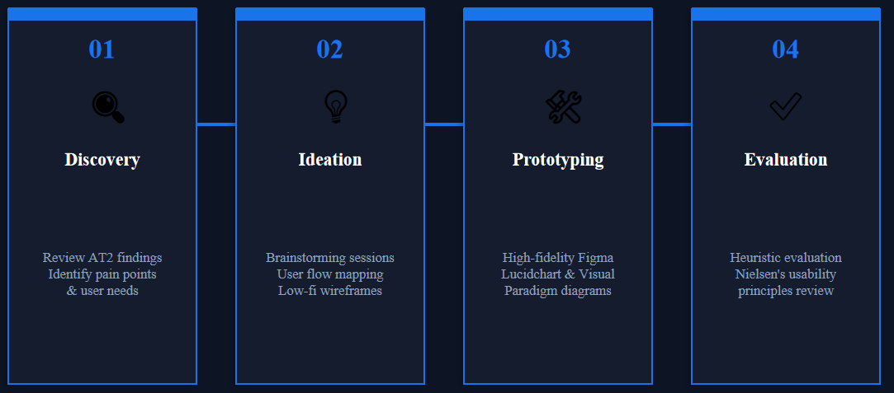
Design Process & Methodology
User-Centred Design (UCD) methodology with 4 iterative phases
Theoretical Framework
• Norman's Design Principles (2013) • Nielsen's 10 Usability Heuristics
• Shneiderman's Eight Golden Rules • ISO 9241-11 (2018)

Slide 5
Key Design Decisions
Evidence-based decisions to address AT2 usability findings
Simplified Dashboard
Consistent Navigation
Progressive disclosure — only balance, recent activity & quick-actions shown initially. Addresses cognitive overload (3/5 score).
Persistent 5-tab bottom nav (Home, Markets, Portfolio, Alerts, Settings). All features within 2 taps.
Guided Auto-Trading Wizard
Improved Error Handling
3-step wizard with DCA, Momentum & Stop-Loss templates. Reduced from 3 min 20 sec to projected 1 min 50 sec.
All errors include: what went wrong, likely cause, suggested fix. Confirmation screen before any funds are moved.
Onboarding Tour
Enhanced Chatbot
Interactive first-time walkthrough with tooltips for key features and trading concepts. Critical for beginner traders.
Context-aware — detects current screen. Quick-reply chips. Human-agent escalation button. Rated 3.6/5 → target 4.3/5.

Slide 6
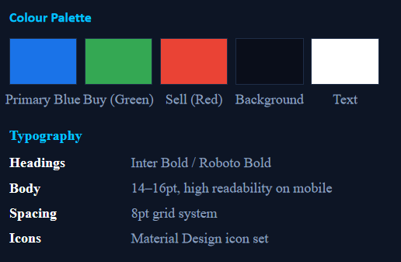
Design System
Consistent visual specifications for a coherent user interface

Slide 7
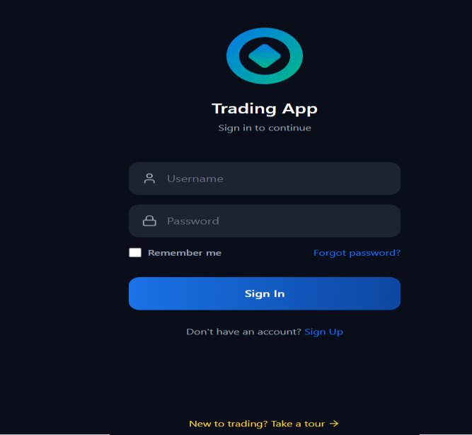
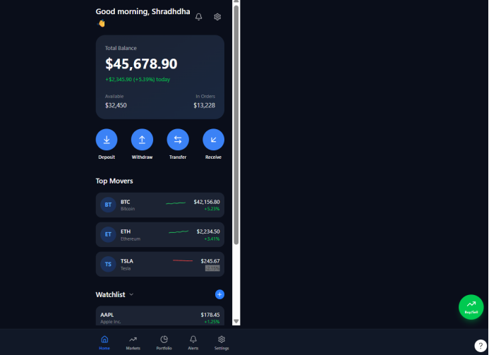
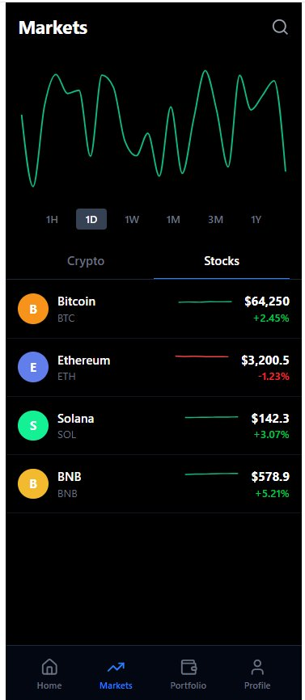
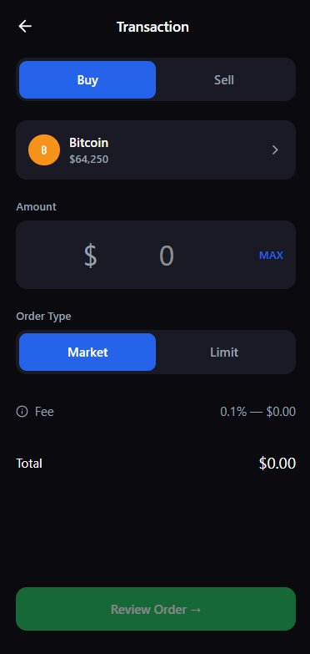
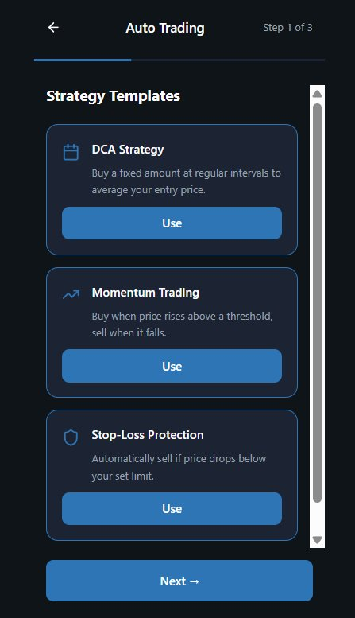
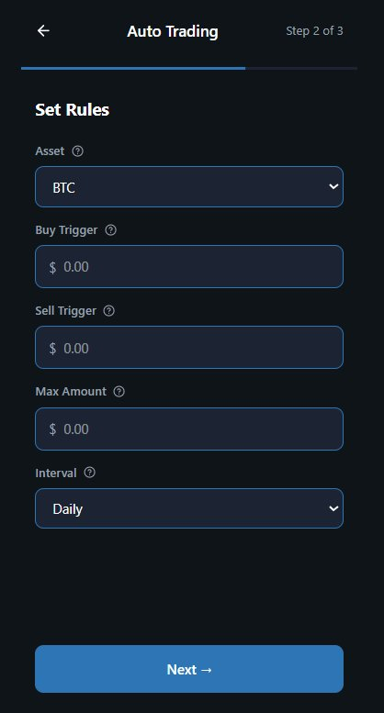
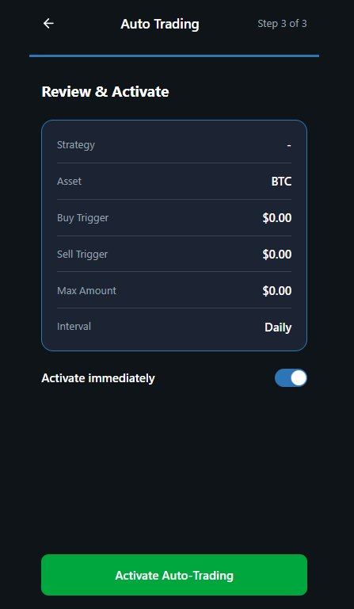
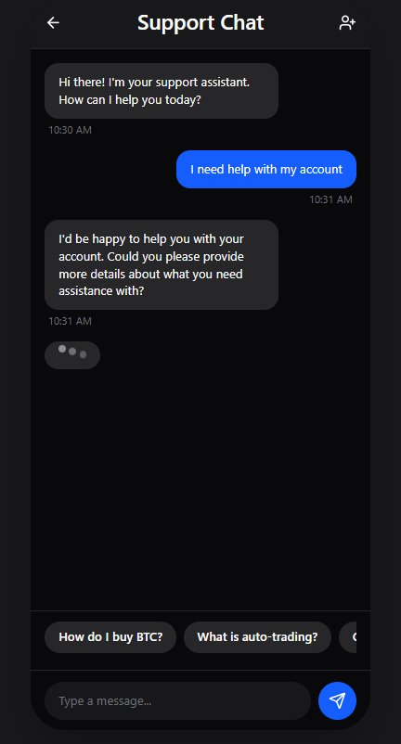
Visuals
8 Key Screens Designed
Figure 1. Login Screen – Trading Mobile Application | Figure 2. Redesigned Dashboard / Home Screen | Figure 3. Markets Screen showing Crypto and Stocks views | Figure 4. Transaction (Buy/Sell) Screen with Review Order flow
Figure 5. Auto-Trading Wizard – Step 1: Strategy Templates | Figure 6. Auto-Trading Wizard – Step 2: Set Rules | Figure 7. Auto-Trading Wizard – Step 3: Review & Activate | Figure 8. AI Chatbot / Support Chat Screen

Slide 8
Auto-Trading Wizard
3-step guided workflow replacing the complex original setup
Step 1
Step 2
Step 3
3 pre-built templates:
• DCA Strategy
• Momentum Trading
• Stop-Loss Protection
‘
Each with plain-language description & 'Use' button. Progress indicator shown at top.
Configure:
• Asset (e.g. BTC dropdown)
• Buy & Sell Trigger prices
• Max Amount
• Trading Interval
'?' tooltip icon on every field for contextual help.
Full summary in clean 2-column card. 'Activate immediately' toggle defaults ON.
Green 'Activate Auto-Trading' button provides closure.
Aligns with Shneiderman's feedback rule.
Strategy Templates
Set Rules
Review & Activate
⚡ Projected improvement: 60% → 85% task completion | 3 min 20 sec → 1 min 50 sec | ~45% time reduction

Slide 9
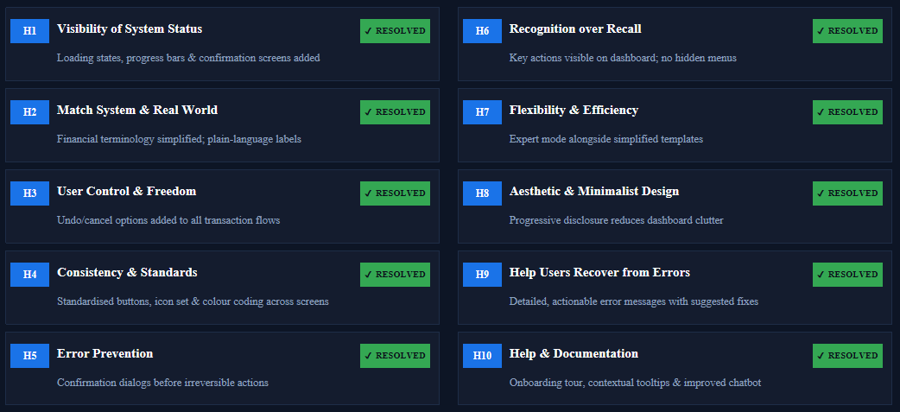
Heuristic Evaluation
All 10 Nielsen heuristics evaluated — all resolved in redesign

Slide 10
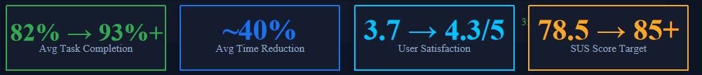
Projected Task Performance Improvements
Before vs. after the redesign — projected improvements based on design changes
Task | Original Rate | Original Time | Projected Rate | Projected Time
Search Cryptocurrency | 100% | 35 sec | 100% | 20 sec
Buy Cryptocurrency | 90% | 1 min 40 sec | 95% | 55 sec
Sell Stock | 80% | 2 min | 92% | 1 min 10 sec
Transfer Funds | 70% | 2 min 30 sec | 90% | 1 min 20 sec
Setup Auto-Trading | 60% | 3 min 20 sec | 85% | 1 min 50 sec
Chatbot Interaction | 90% | 50 sec | 95% | 35 sec

Slide 11
Accessibility & Conclusion
WCAG 2.1 compliance and summary of design outcomes
♿ Accessibility (WCAG 2.1)
📋 Key Design Outcomes
🎨
Colour contrast ≥ 4.5:1 (AA standard) for all text
✓ Simplified progressive dashboard reduces cognitive load
👆
Minimum 44×44pt touch targets (Apple HIG & Material Design)
✓ 5-tab persistent nav — all features within 2 taps
🌙
Full dark mode support with maintained contrast ratios
✓ 3-step Auto-Trading wizard (down from 6 steps)
🔤
Adjustable text size via device accessibility settings
✓ Actionable error messages with clear resolutions
✓ Context-aware chatbot with quick-reply chips
🔊
All images & icons include screen reader labels
✓ First-time onboarding tour for beginner traders
Future Work: Formal usability testing (n=30+) · A/B testing of dashboard variants · Longitudinal studies · AI chatbot with live market data

Slide 12
References
[1]D. Norman, The Design of Everyday Things, Revised and Expanded Edition. New York, USA: Basic Books, 2013. [Online]. Available: https://www.basicbooks.com/titles/don-norman/the-design-of-everyday-things/9780465050659/
[2]J. Nielsen, "Usability 101: Introduction to Usability," Nielsen Norman Group, 2012. [Online]. Available: https://www.nngroup.com/articles/usability-101-introduction-to-usability/
[3]B. Shneiderman, C. Plaisant, M. Cohen, S. Jacobs, N. Elmqvist and N. Diakopoulos, Designing the User Interface: Strategies for Effective Human-Computer Interaction, 6th ed. Pearson, 2016. https://www.pearson.com/en-us/subject-catalog/p/designing-the-user-interface/P200000003054
[4]A. Dix, J. Finlay, G. Abowd and R. Beale, Human-Computer Interaction, 3rd ed. Pearson Education, 2004. https://www.pearson.com/en-gb/subject-catalog/p/human-computer-interaction/P200000005000
[5]ISO 9241-11, Ergonomics of Human-System Interaction – Usability: Definitions and Concepts, International Organization for Standardization, 2018. [Online]. Available: https://www.iso.org/standard/63500.html
[6]W3C, "Web Content Accessibility Guidelines (WCAG) 2.1," World Wide Web Consortium, 2018. [Online]. Available: https://www.w3.org/TR/WCAG21/
[7]J. Garrett, The Elements of User Experience: User-Centered Design for the Web and Beyond, 2nd ed. New Riders, 2011. https://www.newriders.com/9780321683687

Slide 13
Thank You

